Slide 1
205 Oct 31, Class 17
Happy Halloween!
Review of Stephens et al. (2009)
Swearing and pain
Chapter 13, Writing a research proposal

Slide 2
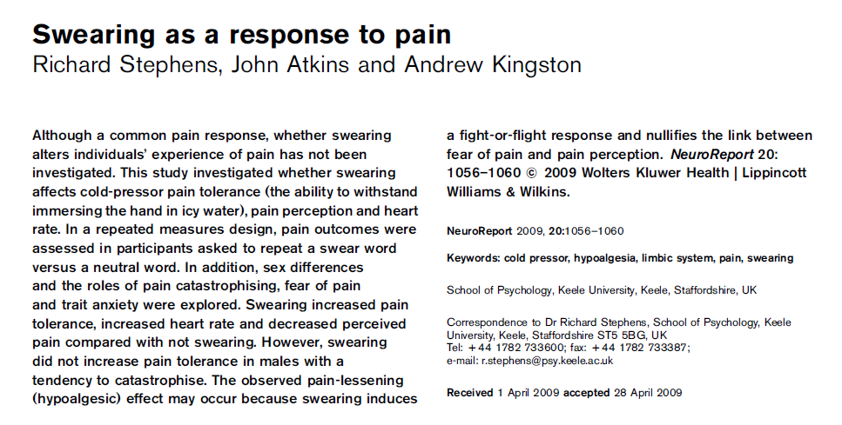
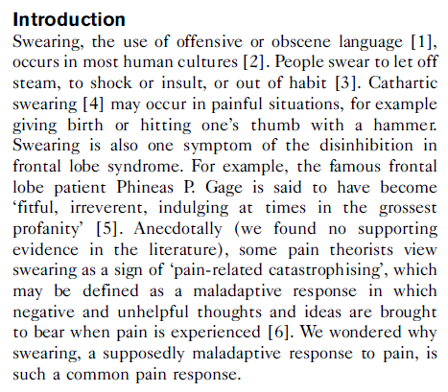
Swearing and Pain

Slide 3
Operational Definitions
Q2. What are the levels of the within-participants factor?
Swearing
Participants were asked for ‘five words you might use after hitting yourself on the thumb with a hammer’ and used the first swear word on the list. As a control they were asked for ‘five words to describe a table’ and used the word whose position corresponded with the swear word.
Participants were asked to maintain a similar pace and volume of word recital across conditions.
One participant was excluded because none of their suggested words were swear words

Slide 4
Assignment questions
Q1. What are the levels of the between-participants factor?
Q3. What is the measured operational definition of ‘pain’ used in this study?

Slide 5
Operational Definitions
Pain
Participants submerged their nondominant hand in the room temperature water for 3 min before each cold pressor trial to create a standardized starting point.
Then the participants immersed the same hand in the cold water with the instruction that they should submerge their unclenched hand for as long as they could, while repeating their chosen word.
Timing began when the hand was fully immersed and stopped when the hand was fully removed from the water. A 5-min time limit was imposed; 10 participants reached this limit in one or both trials.
Participants immersed the hand in the room temperature bath before the second and final trial.

Slide 6
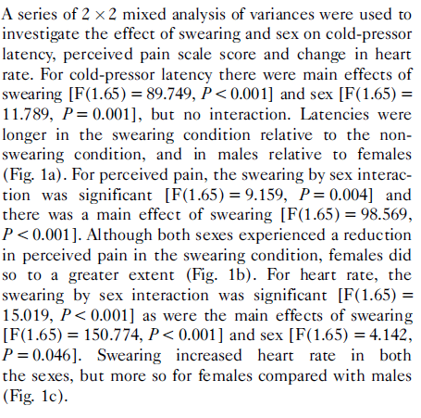
Results
Reporting the results of a series of 2x2 ANOVAs
Some information missing
Best practice is still always to report all main effects, then interactions
Support all statements with F-ratios and p-values

Slide 7
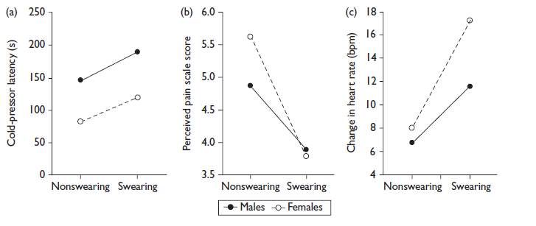
2x2 Analysis
Q4. Describe the interaction observed between the factors on the Perceived pain scale score measure (Figure 1b).

Slide 8
Non-best research practices
Q5. In the Mythbusters episode they did not counterbalance the order of the within-participants factor and additionally excluded participants who scored at the maximum value allowed on the paid measure (neither occurred in the original publication).
Explain how each of these reduces the internal validity of their version of the study.

Slide 9
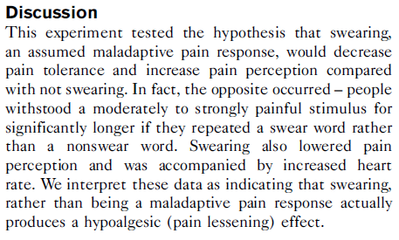
Discussion
Interpretation focuses on swearing effect
Brave enough to present as inconsistent with the original hypothesis
Sex effect was not consistent with all prior research
XX vs XY physiology
Cold pressor is affected by subdural fat deposition

Slide 10
Preparing a Research Proposal
Organize into groups of 3-4 students
If you have trouble finding a group, email us
Meet and pick out your first main source paper
Use for operational definitions
Starting point for procedure
Prepare your initial proposal for Friday 11/4
Guidelines in Chapter 13

Slide 11
Initial Proposal Outline
Group members
Tentative project title
First background source (APA Reference Style)
Design of source experiment
IV(s), DV, number of participants, outcome
What new element are you planning to add?
Diagram your 2x2 design
2 factors, 2 levels each
Planned number of participants
 | Factor1-a | Factor1-b
Factor2-x
Factor2-y

Slide 12
Collaborative Research
Work together on design, data collection, analysis
Shared Methods & Results section
Work separately on Introduction, Discussion, Abstract
Make your own figures
Differing interpretations of the results are possible
Each paper is your own (first author)
Academic integrity
Building on other author’s ideas is not plagiarism, citations strengthen papers
Taking other people’s words as your own is plagiarism
Data fabrication is fraud

Slide 13
Practical points
Design must be 2x2
At least one factor must be manipulated across groups
Randomly assigned
Minimal ethical risk to participants
No personal/private information
No deception other than blind to conditions
No emotional manipulations
Online data collection can be used
Qualtrics: https://www.it.northwestern.edu/software/qualtrics/index.html

Slide 14
Planning for Final Proposal
Submit to us as if we are the IRB
Present a full description of your protocol
Motivating hypothesis
Procedure as a draft of your Methods section
All stimuli to be used
Working version of an online survey including all conditions
No data collection until explicit approval
Once approved, go as quickly as possible

Slide 15
For Wed, Nov 2
Chapter 14: Non-experimental design
15: Surveys and instrument design
16: Statistics 3, Correlation and Chi2
17: Field research
18: Ethics 2, Responsible Conduct of Research
19: Intervention research design
20: Special topics, Development and Neuropsychology
Final project timeline
Groups & ideas, 11/4
Full proposal, 11/9
Class presentations: 11/21 & 11/23 (Remotely on zoom)
Writeup due, 12/9

